Slide 1
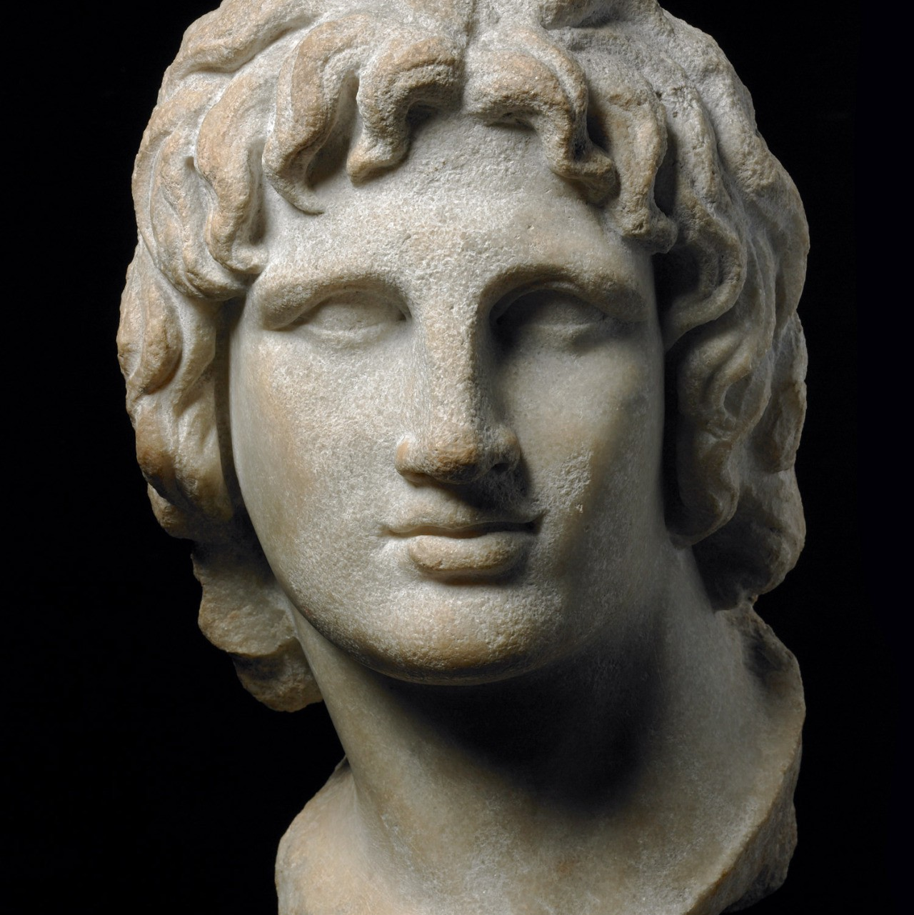
ATG – Background and Early Life
Year 11 Ancient History
Week 2 – Lesson 1

Slide 2
Who is he?
Alexander the Great is often considered to be one of the ‘greatest’ military leaders that the world has ever know. Building on the great military successes of his father, Philip II, Alexander created an empire that covered the entire eastern Mediterranean world.

Slide 3
Watch the following video for an overview of ATG
https://www.youtube.com/watch?v=FyjAyIyXOeM

Slide 4
Early Life
Born 356 in Pella, capital of Macedonia
Son of Philip II (ruled 359-336BC) and Olympias
Philip – Great military leader
Olympias – Passionate and hot-tempered
ATG and his sister were raised in Pella's royal court
Hardly ever saw his father: spent most of his time engaged in military campaigns and extra-marital affairs
Although Olympia served as a powerful role model for the boy, Alexander grew to resent his father's absence and philandering

Slide 5
Boyhood
More ambitious than his father
“My father will get ahead of me in everyting, and will leave nothing great for me to do”
Olympias taught him that Achilles was his ancestor, and that his father was descended from Heracles
Learned by heart the Illiad and carried a copy with him
At age 12, Alexander showed impressive courage when he tamed the wild horse Bucephalus, an enormous stallion with a furious demeanor. The horse became his battle companion for most of Alexander’s life

Slide 6
Influences
343 B.C. King Philip II hired the philosopher Aristotle to tutor Alexander
Over three years, Aristotle taught Alexander and a handful of his friends philosophy, poetry, drama, science and politics.
Seeing that Homer's Iliad inspired Alexander to dream of becoming a heroic warrior, Aristotle created a version of it for Alexander to carry with him on military campaigns.
Alexander completed his education at Meiza in 340 B.C.

Slide 7
Rise to power
At 16 he is given command of Macedonia while his father is at war against Byzantium
At 18 he commands a part of Philip’s cavalry at the Battle of Chaeronea and acted as his father’s ambassador in Athens
At 20 he becomes King of Macedonia after his father’s death in 336 BCE
How did Alexander gain his power?

Slide 8
What you might not know...
Determined to seize throne by any means necessary
Used the support of the Macedonian army/troops he had fought with
Army proclaimed ATG as the king
Secrets of his uprising.
Army helped him to murder other potential heirs to the throne
Olympias helped, slaughtering daughter of Philip and Cleopatra

Slide 9
Revolts
After Alexander became king, the surrounding territories revolted
The city of Thebes in Greece was the first to start the revolt
Alexander’s advisors viewed that he should give up the Greek territories and not take action
Alexander decided against this and subdued the territories with lightning speed starting with Thebes.
Alexander and his army stormed the city of Thebes and destroyed every building except the temples and the house of the poet Pindar
30,000 inhabitants were sold into slavery
Seeing this, the rest of the territories surrendered and Alexander then had control of Macedonia and Greece.
Thebes and the citizen’s uprising

Slide 10
3.2.1. R. I. Q 3. Three new things you learned today from this lesson 2. Two facts about key people, events, or ideas 1. One question you now have about Alexander the Great
SUMMARY

